Slide 1
Code Review
09/12/2019

Slide 2
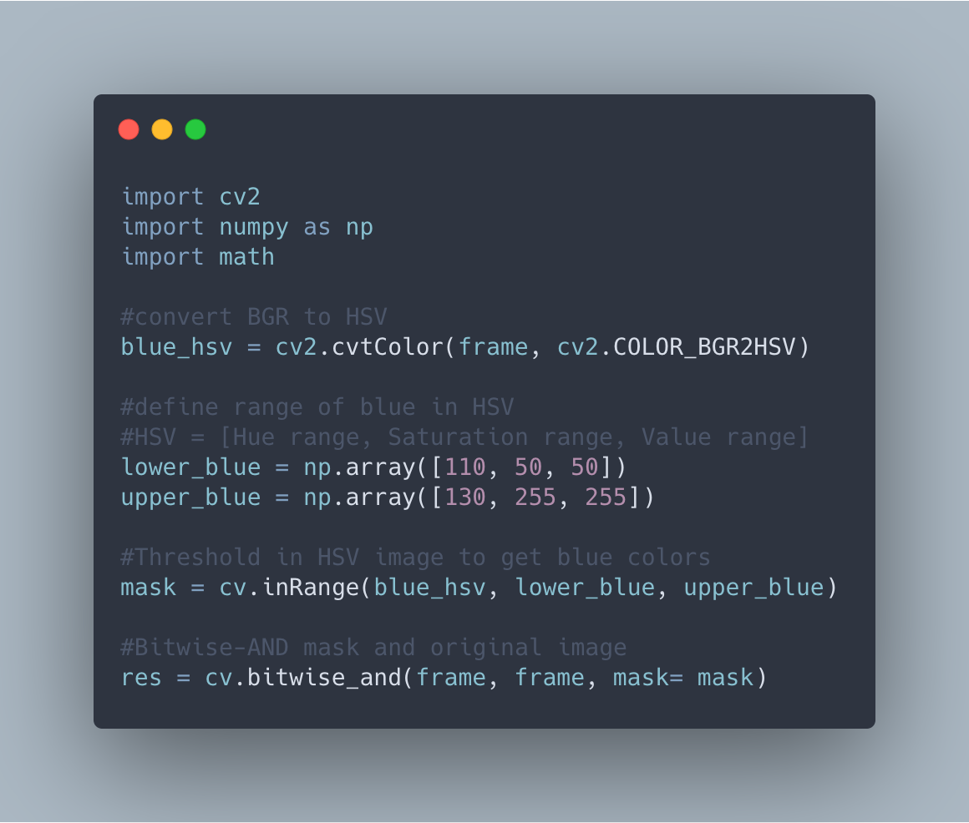
Res
Mask

Slide 3
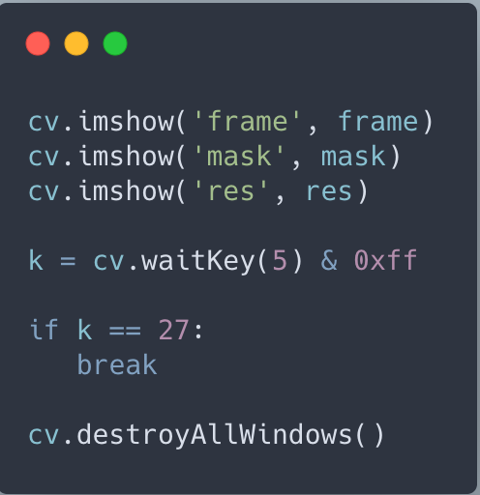
imshow( ) is the method to show an image or video to the output screen. Its parameters are (window name, output file)
Need to use 0xff to offset because of system architecture

Slide 4
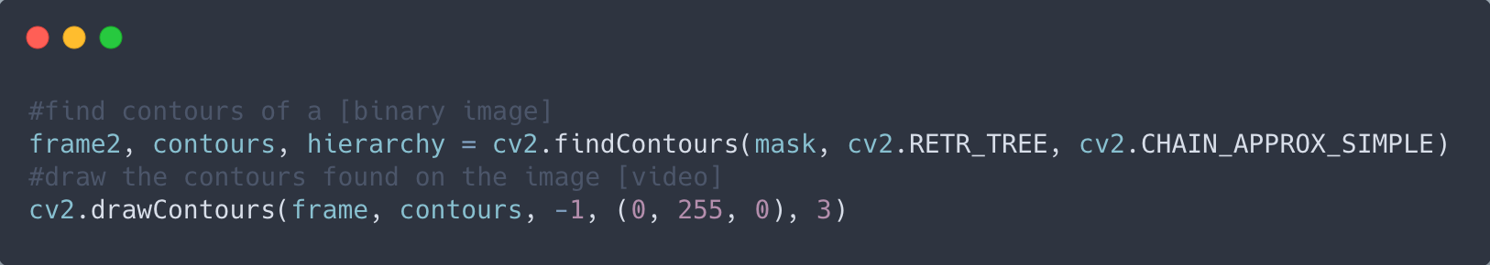
Most successful when you have a white object against a black background
- Need to apply masking, threshold, or Canny Edge Detection
Contours – continuous points surrounding an object
Contour approximation method
Contour retrieval mode

Slide 5
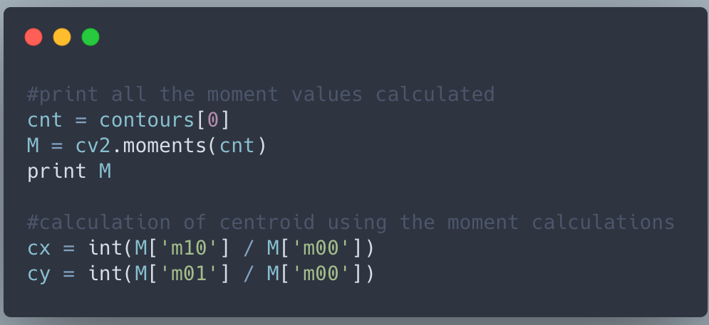
Moments – an aggregated measure of vectors
Used to find the center of mass of an object

Slide 6
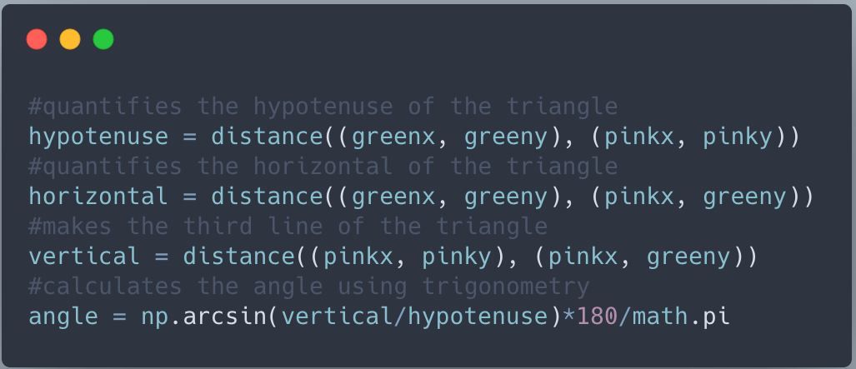

Slide 7
Add a flow chart through the process in github
Draw a line for where the angle is being detected from.

